Slide 1

Environment
BPAS Workshop 2

Slide 2
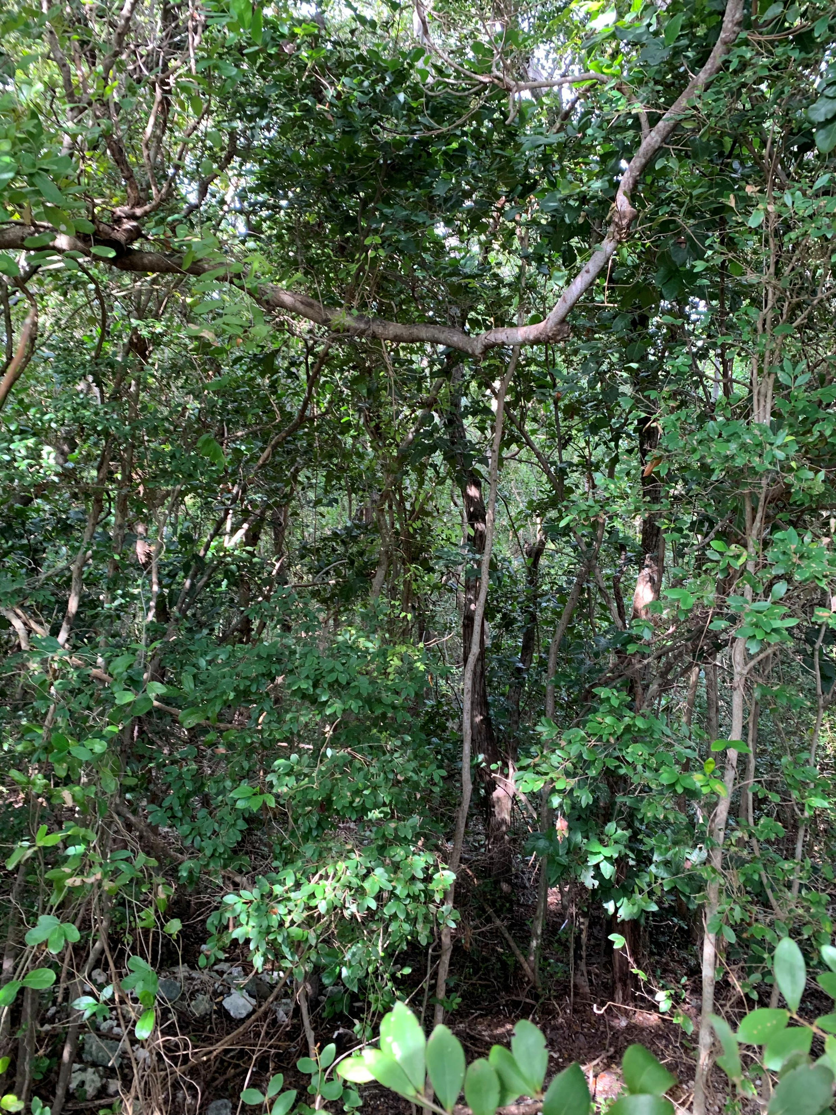
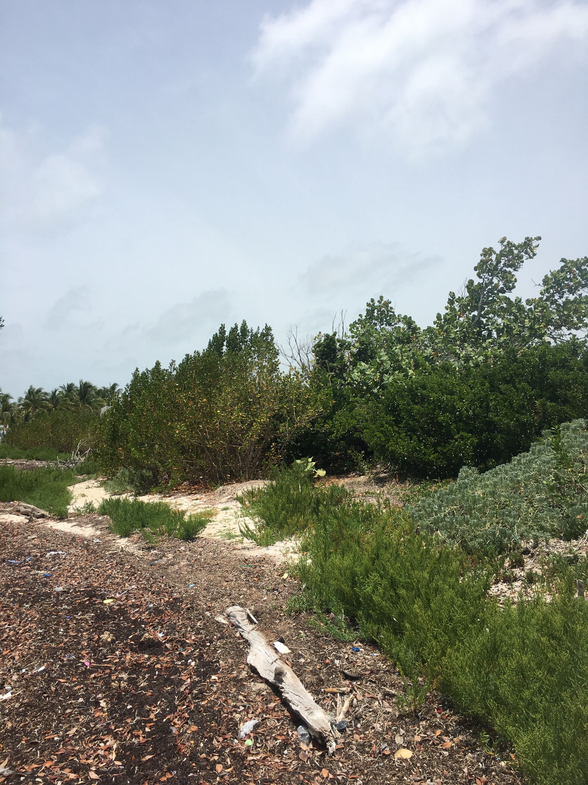
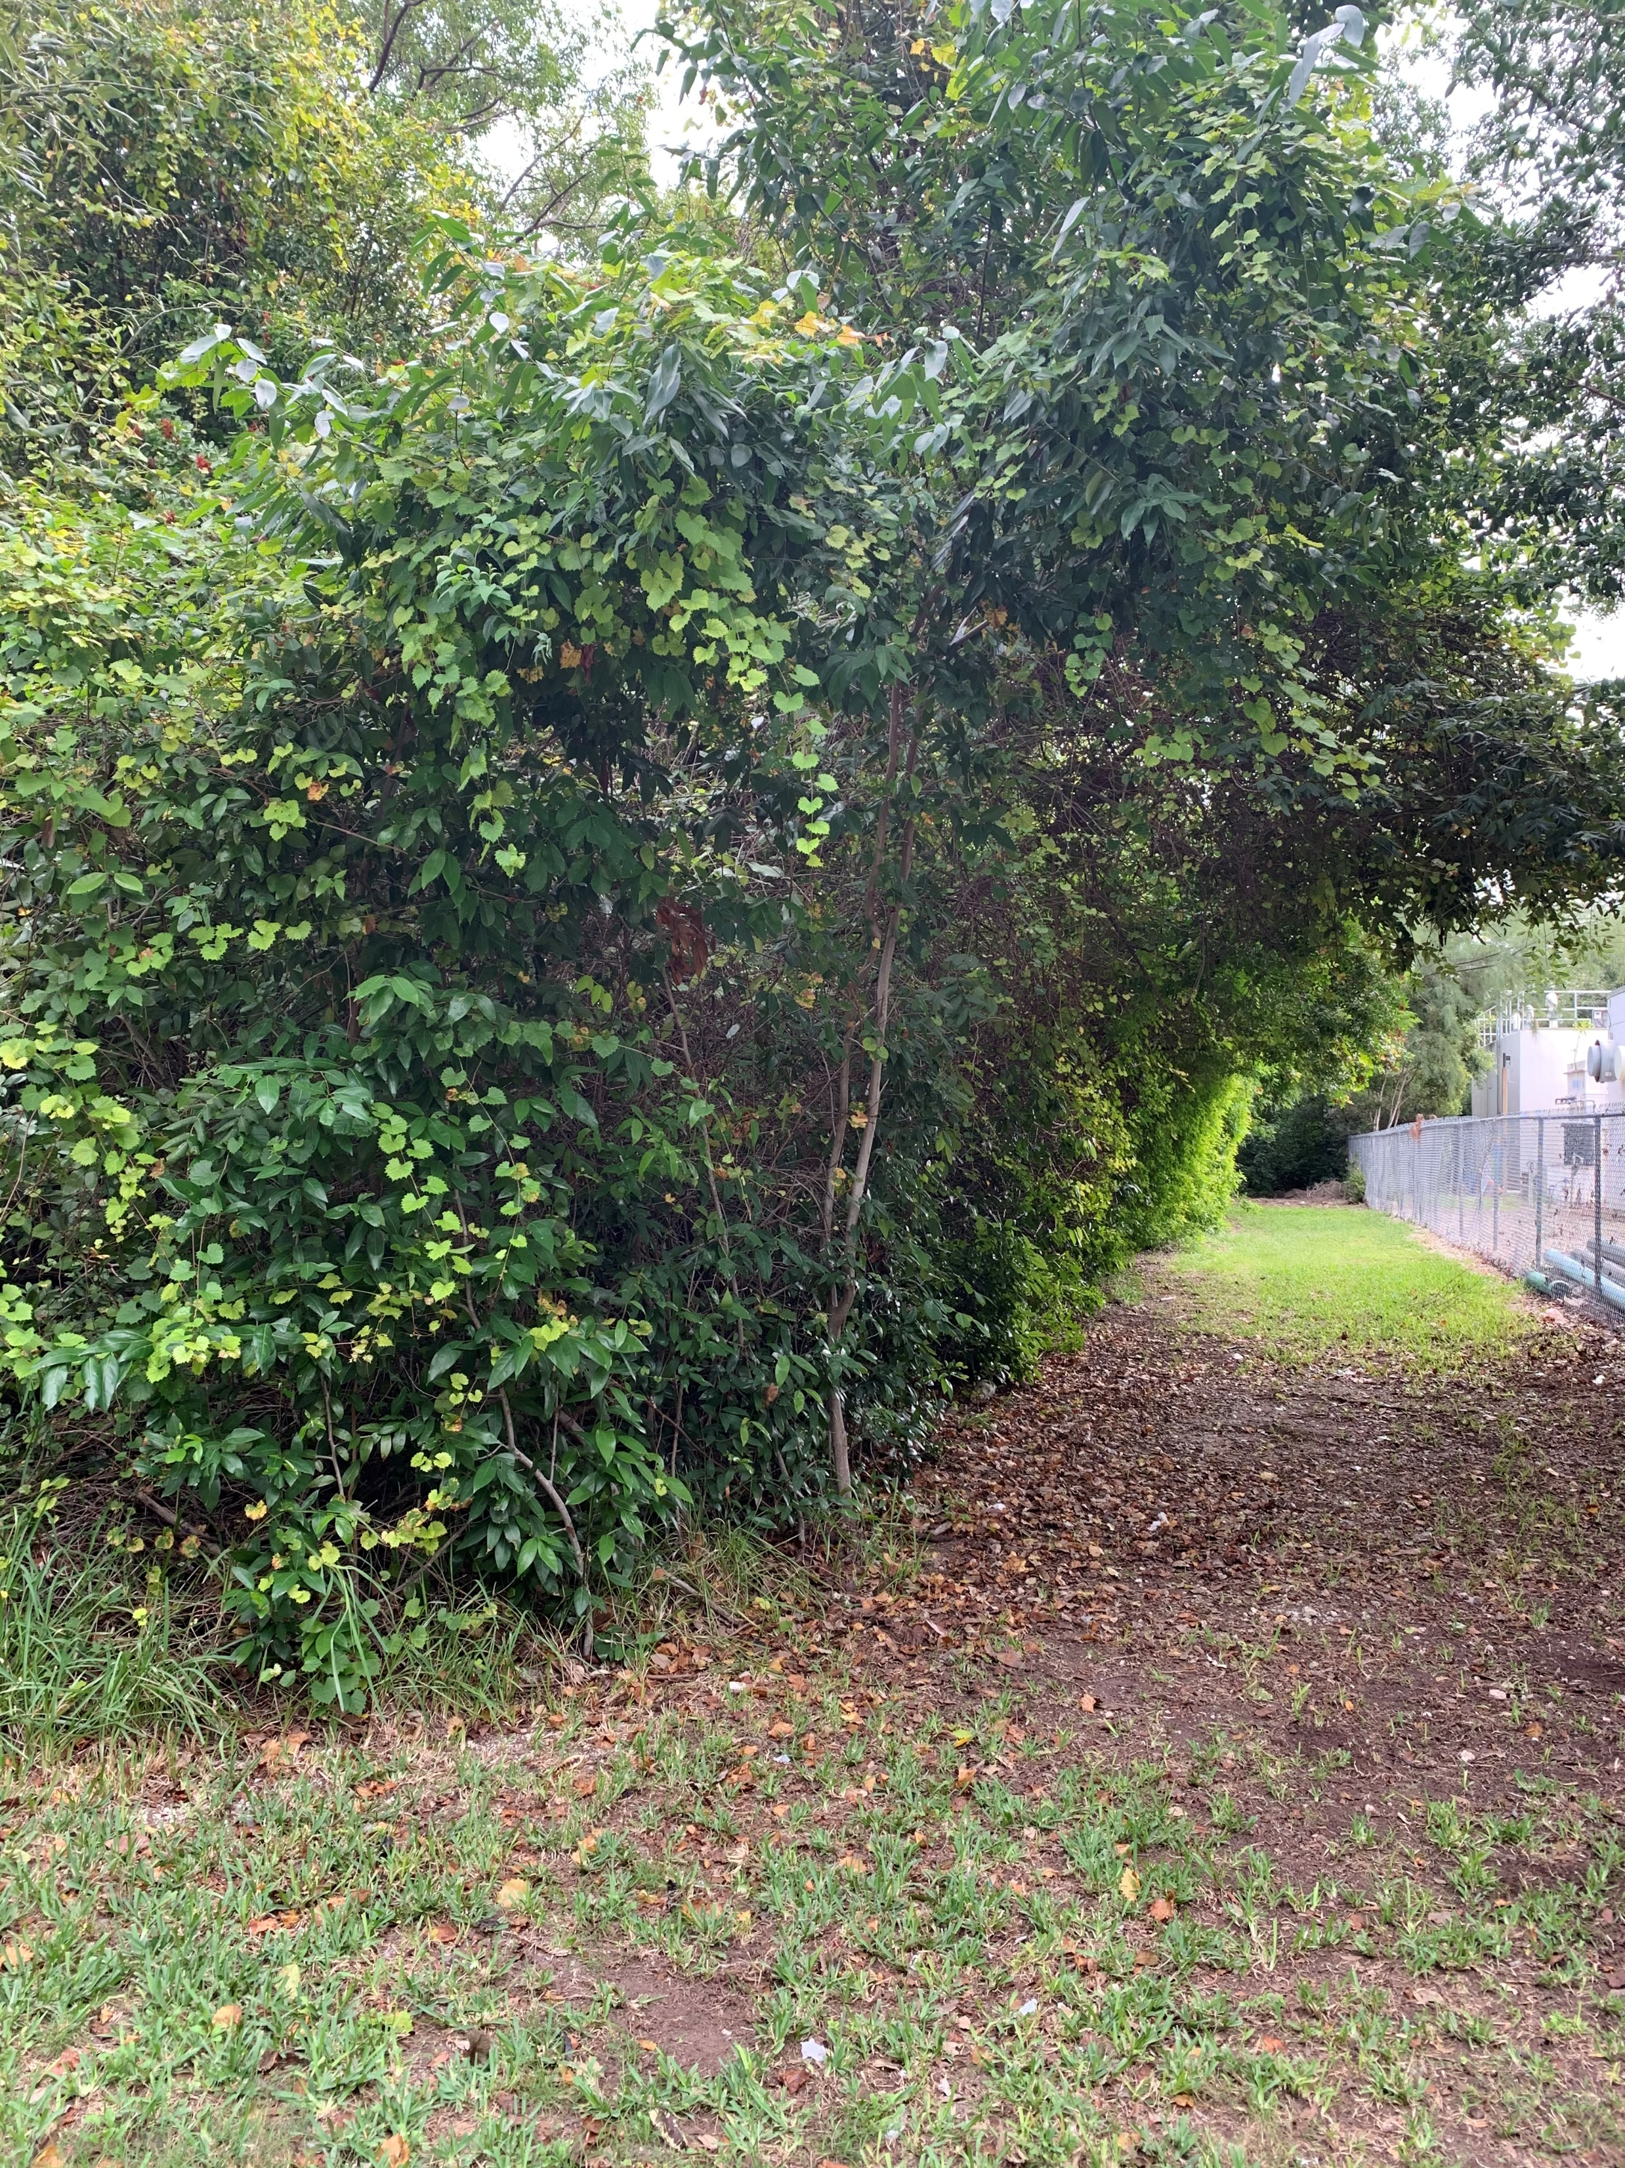
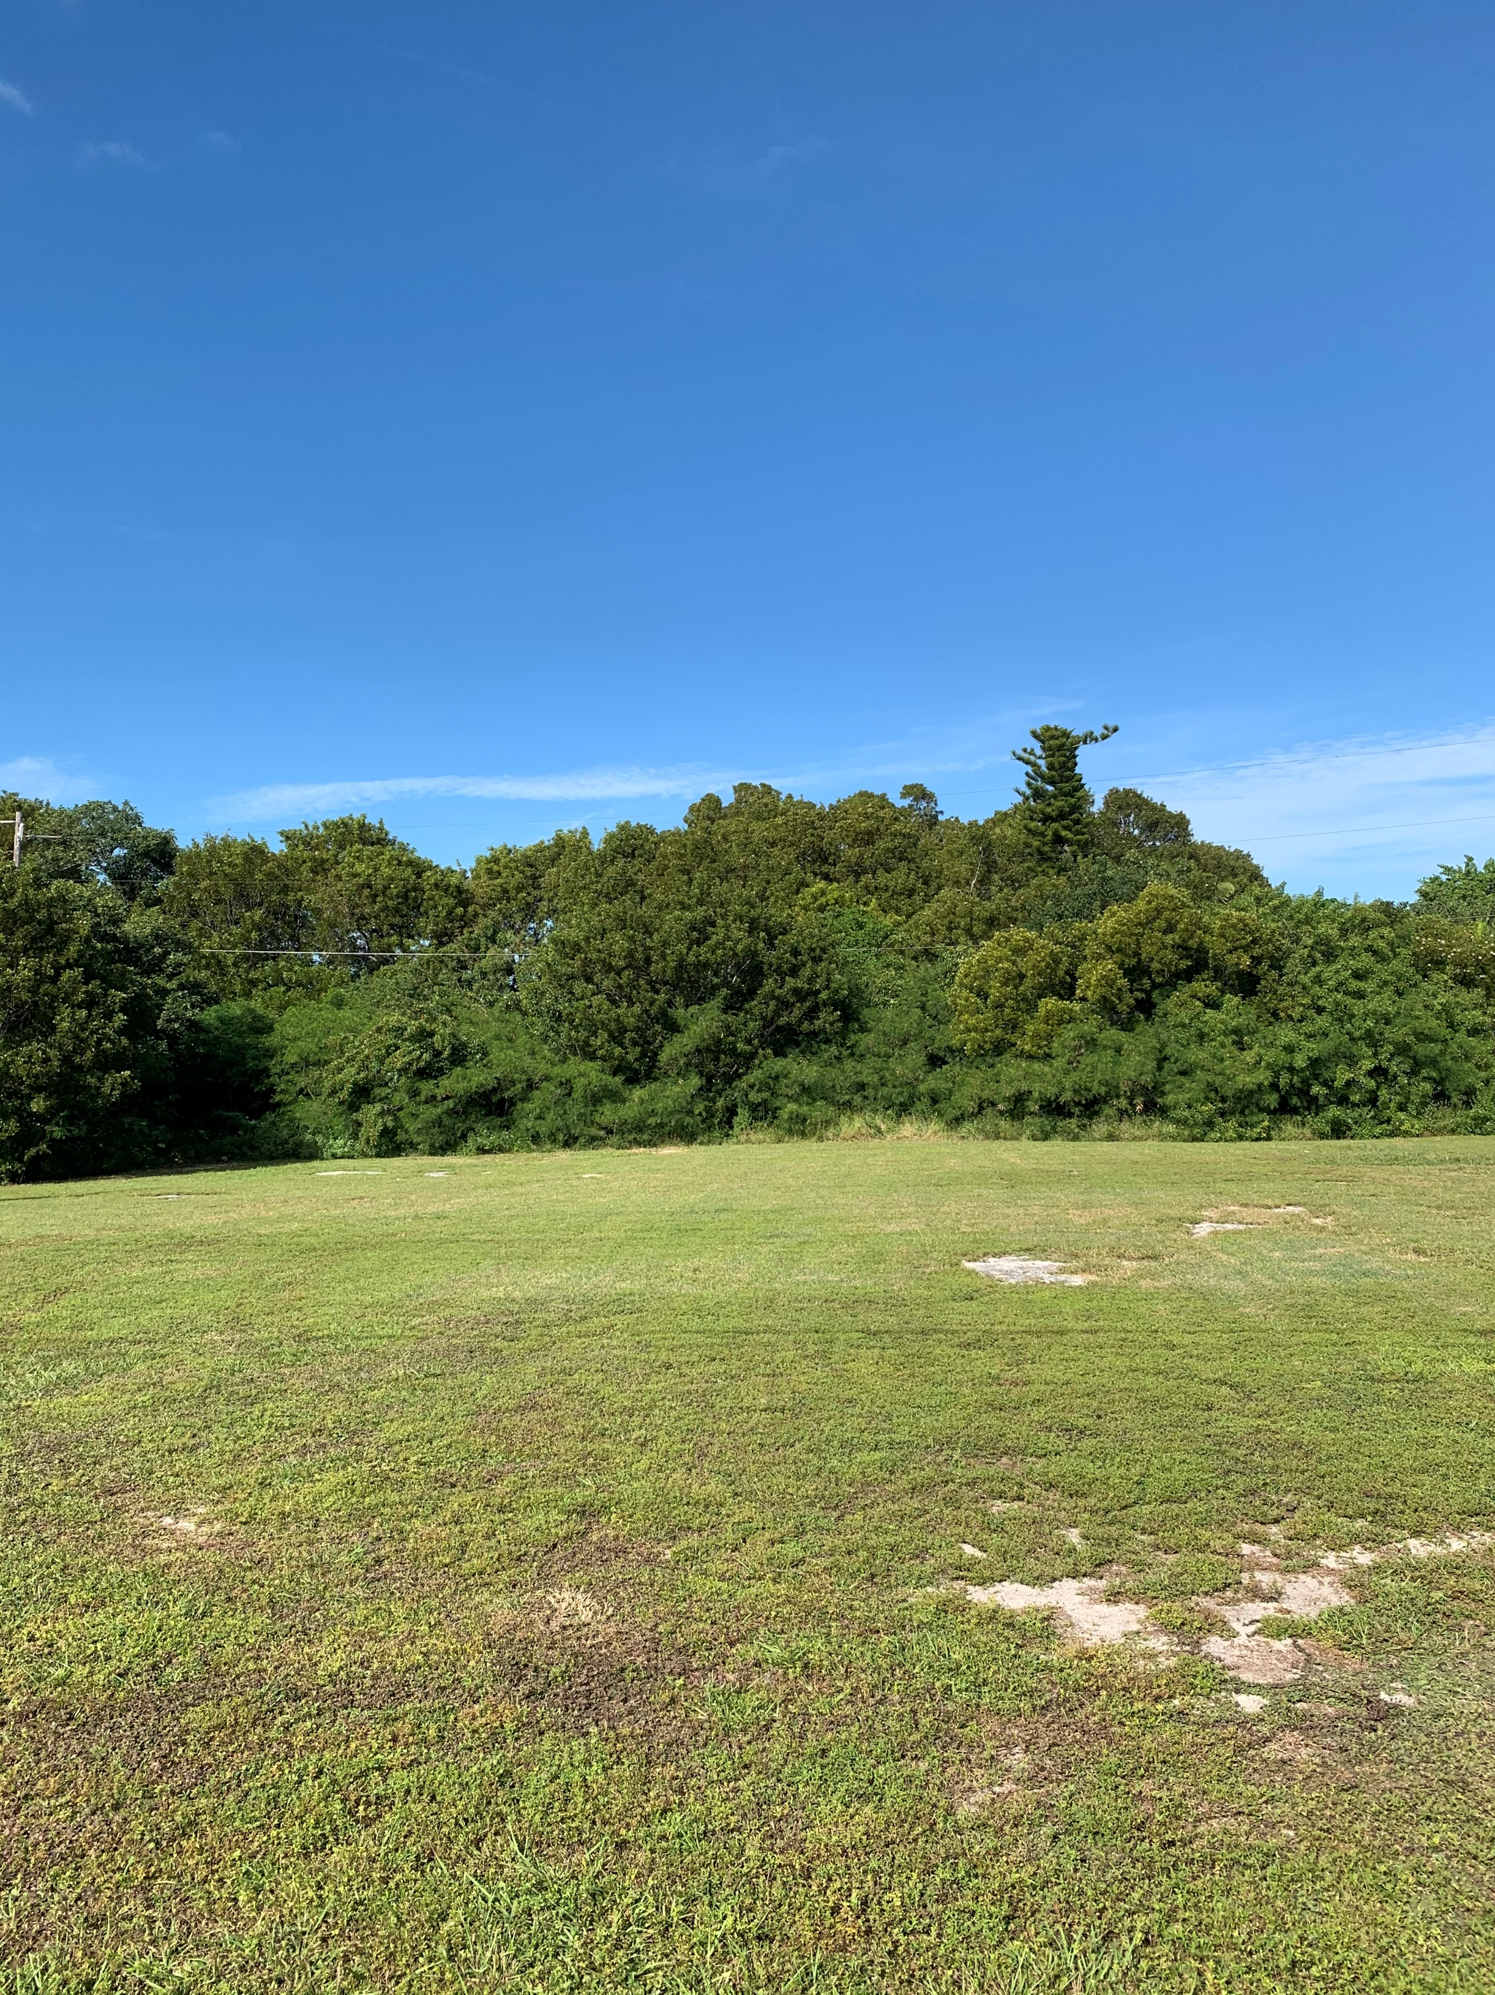
Types of habitat
Upland
Hamock
High Quality
Medium Quality
Low Quality
Beach Berm
Disturbed
With Hammock
With Beach Berm
With Exotics
Scarified

Slide 3
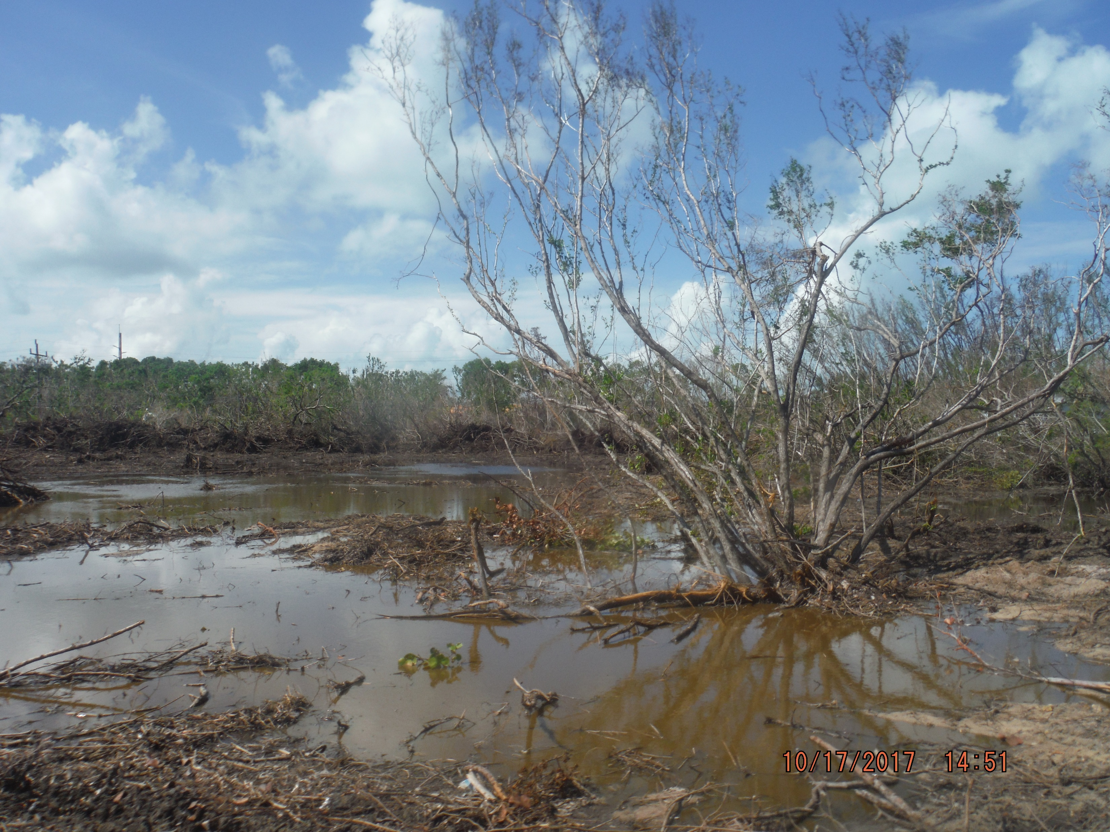
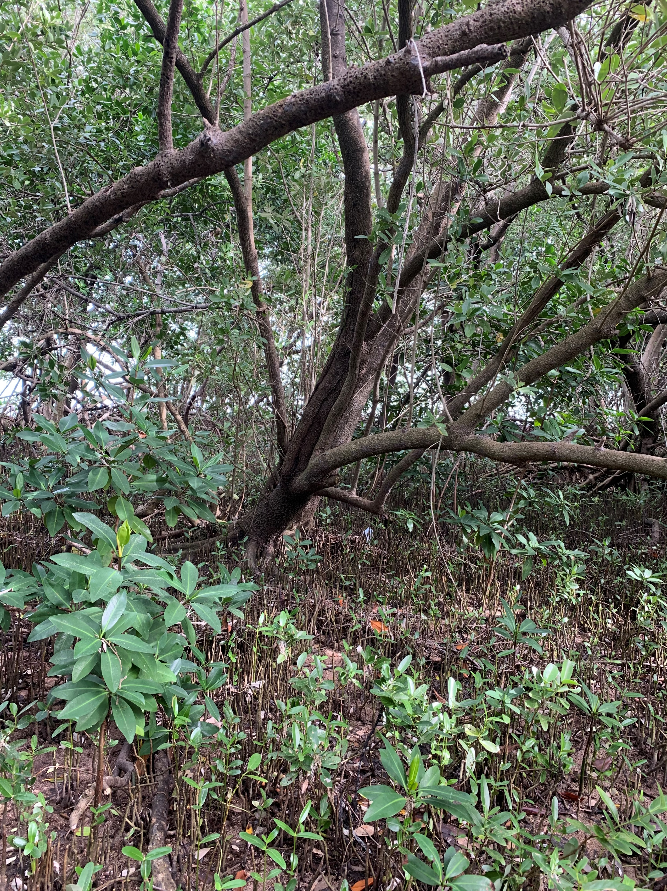
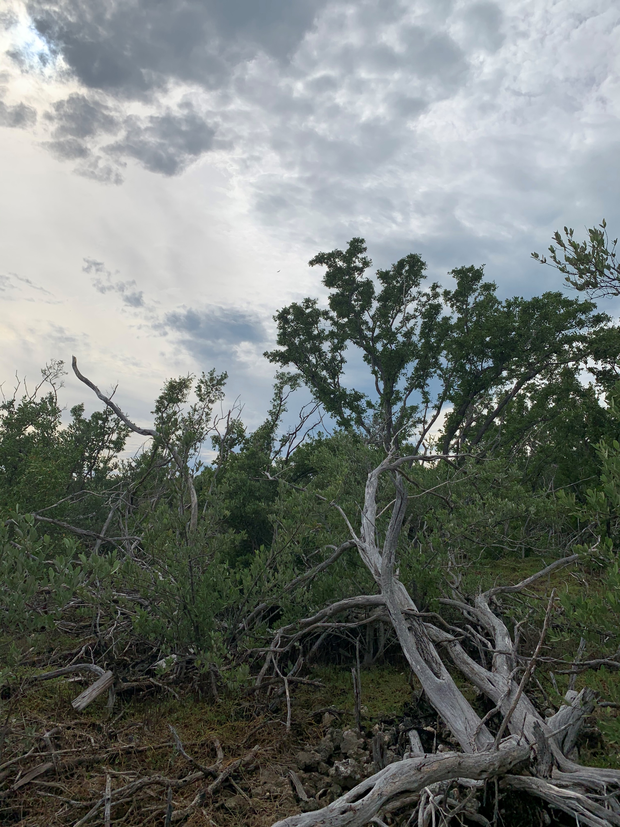
Types of habitat
Wetlands
Mangrove Wetlands
Saltmarsh and Buttonwood
Wetlands
Disturbed with Saltmarsh and Buttonwood
Wetlands

Slide 4
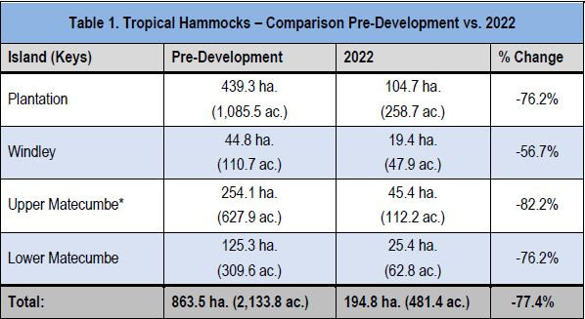
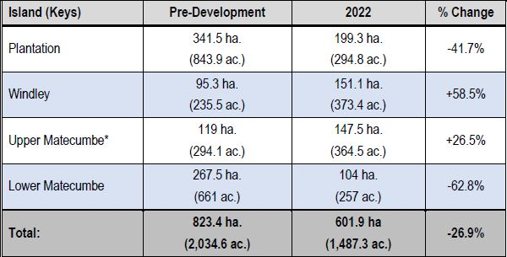
Habitat Changes

Slide 5
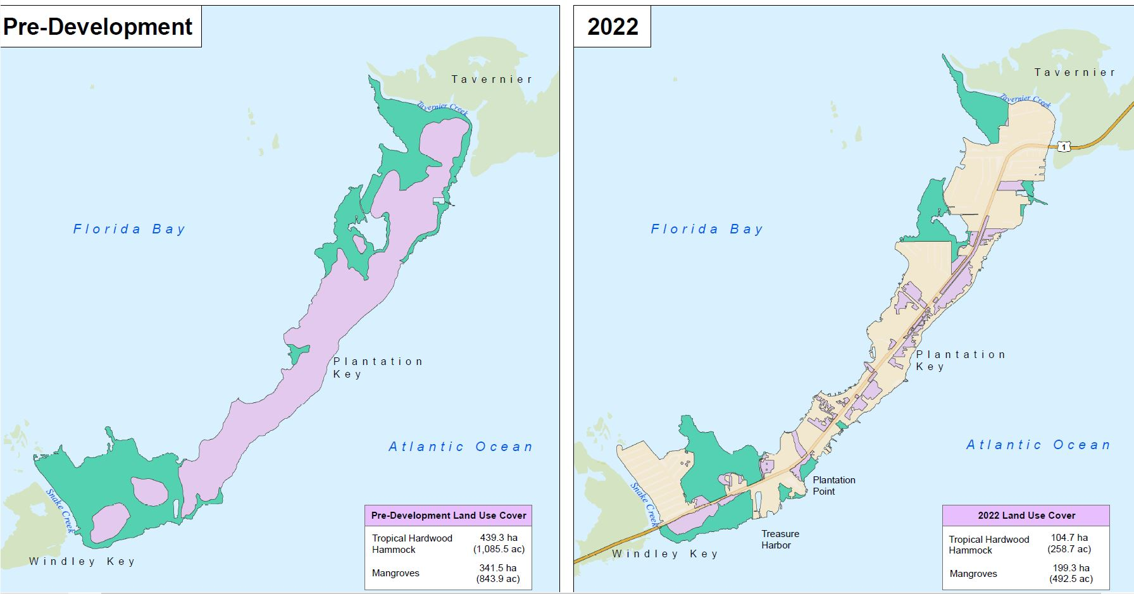
Habitat Changes
Graphical

Slide 6
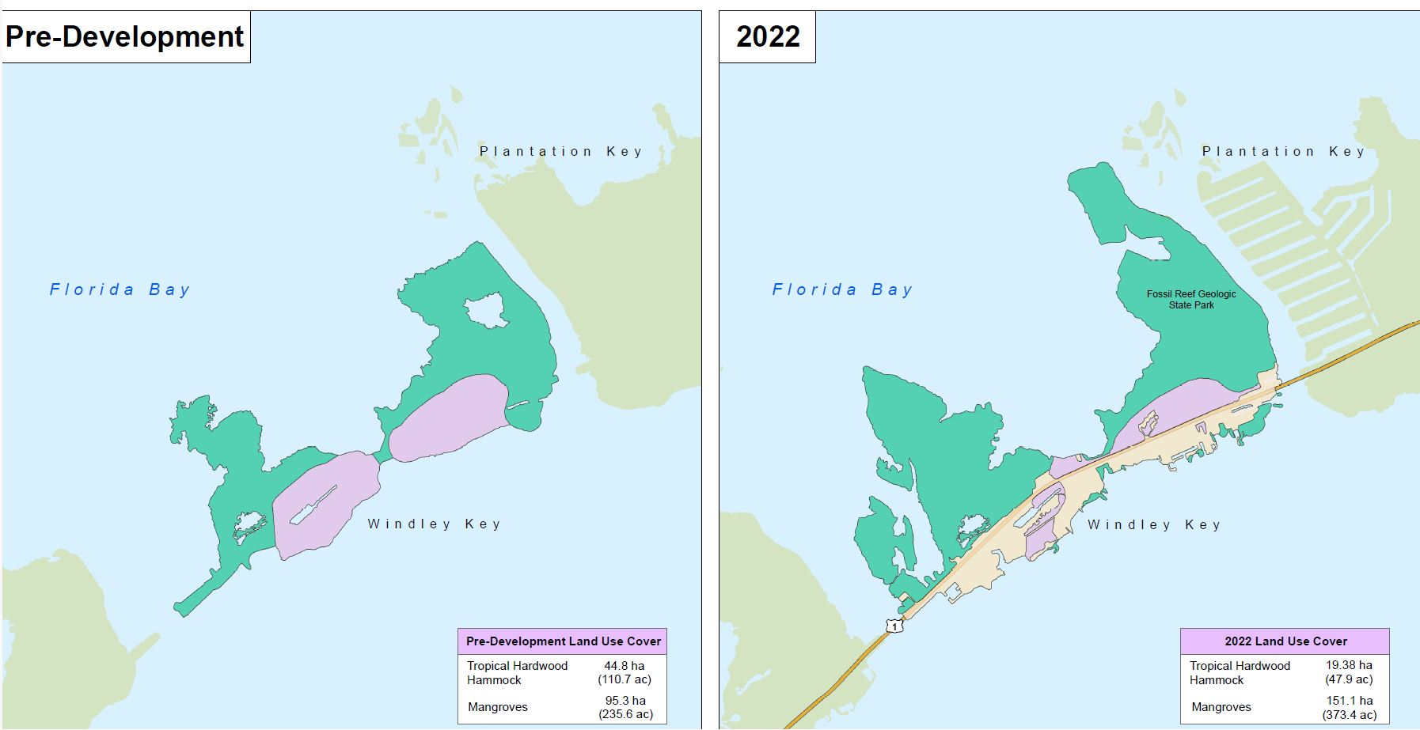

Slide 7
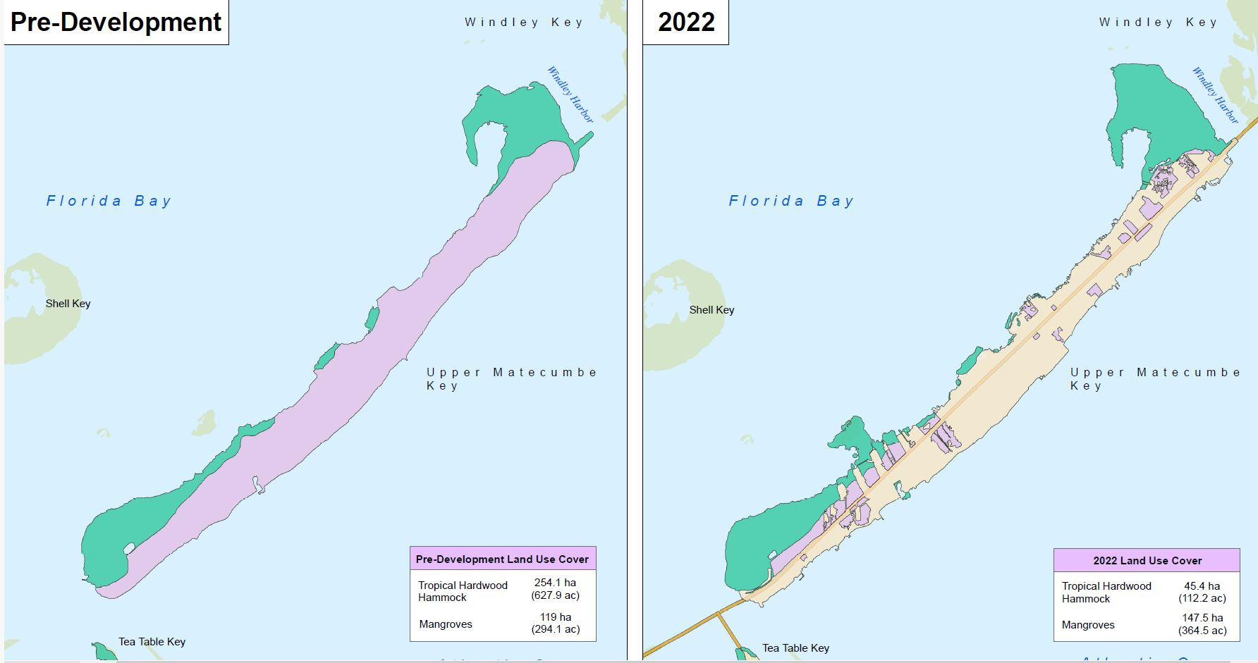

Slide 8
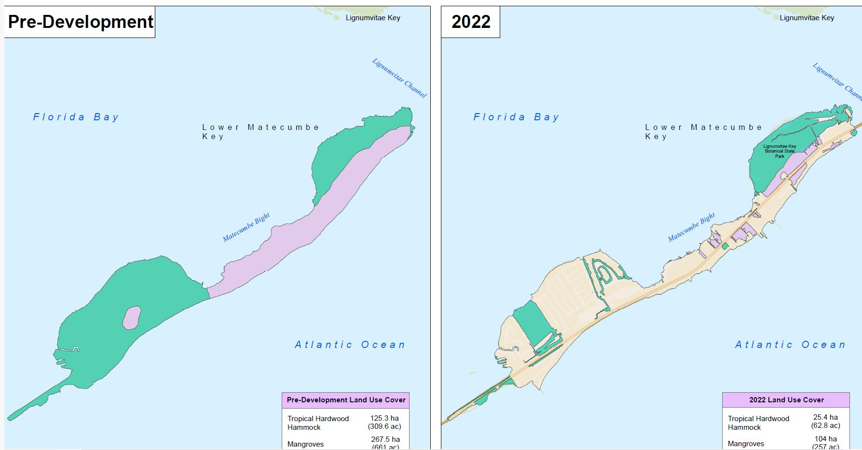

Slide 9
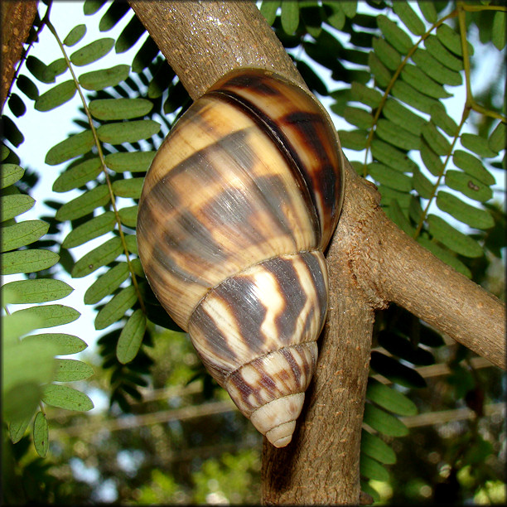
How do environmental factors effect BPAS?
Habitat Protection
-10: High quality hammock, beach berm, saltmarsh buttonwood wetlands
-7: Moderate quality hammock
-2: Low quality hammock and disturbed with habitat categories
+1: Disturbed or scarified
Threatened and Endangered Species
-10: Known habitat of a documented endangered species
-10: Within 100’ of a known sea turtle nesting area
-5: Probable or potential habitat of a threatened or endangered species
-2: Within habitat of a wide-ranging threated or endangered species
Critical Habitat
-10: Within a Florida Forever acquisition area

Slide 10
What environmental protections are in place now?
Require Conservation Easements
Required when developing in hammock
Hammock under easement protected in perpetuity
Limit Clearing
High quality hammock: 10% max
Moderate quality hammock: 30% max
Low quality hammock: 50% max
Protect seagrass and coral
No development over hard bottom
Min depth required over seagrass
Protect Wetlands
Development prohibited in undisturbed wetlands
90% open space required for disturbed wetlands
Protect Sea Turtle Nesting
Lighting restrictions
Setback requirements from nesting areas
Replace Trees
Mitigation required for removing any native tree
Require Open Space
20%-90% depending on habitat

Slide 11
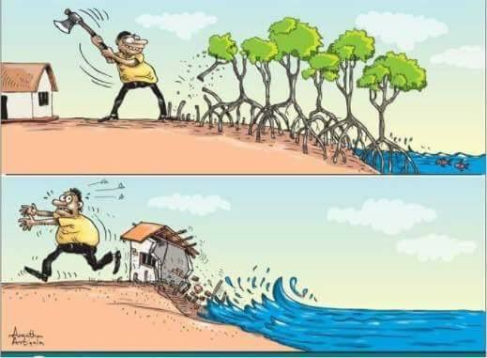
How do you feel about the current regulations? BPAS? Allocations?
What would you like to change?
Let us know!

Slide 12
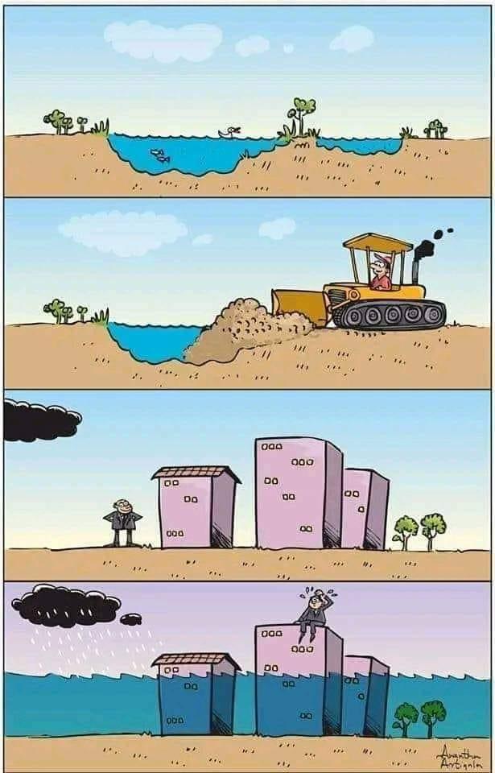
How do I get involved?
You are! Workshops like this!
Comp Plan Update: Provide public comment
Meet with council members or staff: we don’t bite (well staff doesn’t…).
Answer online surveys

Slide 13
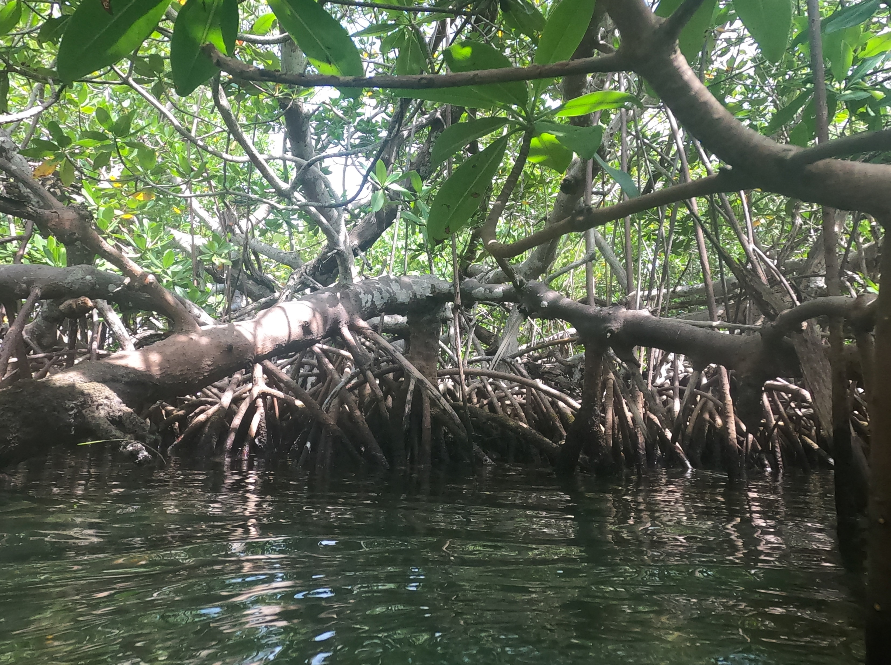
Thank you!

