Slide 1

BPAS Workshop Infrastructure Discussion
Traffic/Roads
Potable Water
Wastewater
Solid Waste
Stormwater
Notes:
Good afternoon and thank you for attending the 2nd BPAS Workshop. My name is Rob Mather, and I work for the Village in the Planning Department as a review engineer. The goal of this presentation is to provide information pertaining to our infrastructure, both locally and countywide, as we brainstorm how to proceed with providing our input on BPAS allocations to the Monroe County BOCC.
In this presentation, I will be discussing the current status and capacity of our traffic and roads, potable water system, wastewater system, solid waste management, and stormwater management.
I ask that you please hold your questions until we open the floor for questions at the end. Also please understand that we may not have all the answers to specific questions at this time. I would like to make it clear that this information is intended to be a general overview of our infrastructure and is not any type of specific capacity study.

Slide 2
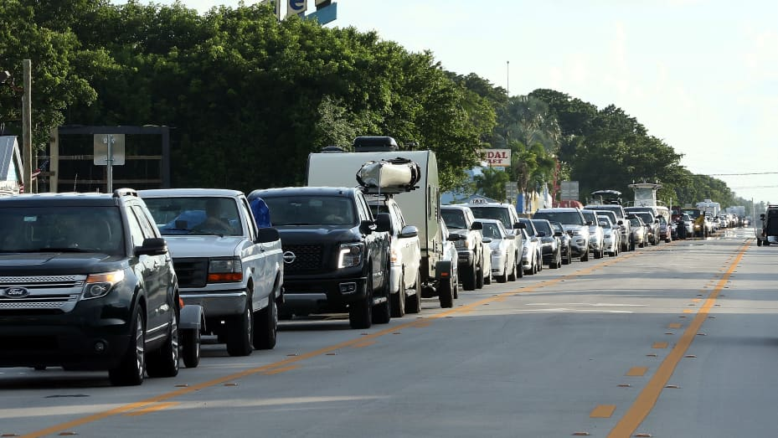
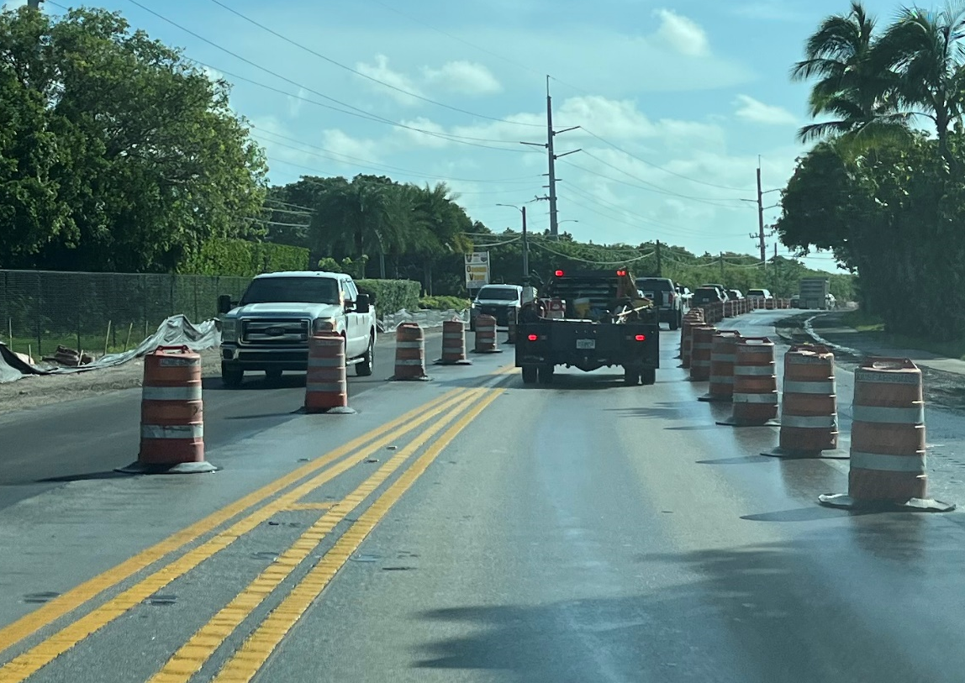
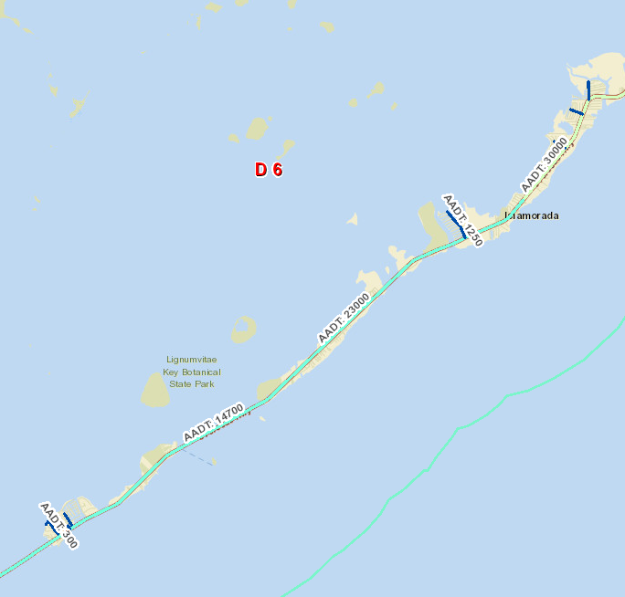
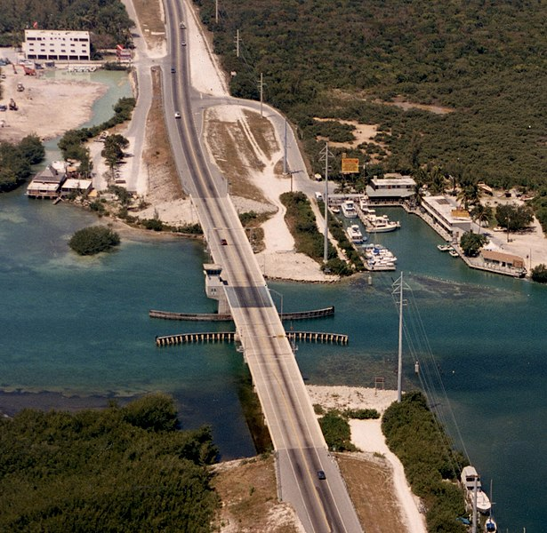
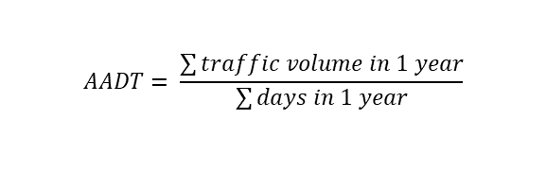
Local Traffic Conditions
Key Question: Why do we experience traffic delays in Islamorada?
FDOT Projects:
US-1 Resurfacing Venetian Blvd to Executive Bay Club - Construction 2026
US-1 Resurfacing MM 87.21 to MM 90.16 - Construction 2027
Snake Creek Bridge PD&E Study – Future Project > 5 Years
FKAA Projects:
Islamorada Transmission Main MM 79 to MM 84 – Completed July 29, 2024
Windley Key Transmission Main – Expected Completion Jan 2025
Snake Creek Crossing
Plantation Key Transmission Main Replacement – Estimated Construction 2025
Traffic/Roads
1987 Aerial
$$AADT= \frac{\sum{traffic volume in 1 year}}{\sum{days in 1 year}}$$
For FDOT Projects:
https://fdotewp1.dot.state.fl.us/fmsupportapps/workprogram/WorkProgram.aspx
2023 FDOT AADT Measurements per https://tdaappsprod.dot.state.fl.us/fto/
Notes:
To understand why traffic can be so severe in Islamorada, lets not “delay” in discussing some of the local background conditions. A good question to start with is: why do we experience traffic delays in Islamorada? We have a limited roadway network in the Keys. US-1 (aka Overseas Hwy) is the main arterial roadway that connects the Islands from Key West to Miami-Dade County. Local roadways are available on some islands, however, you still have to traverse US-1 to travel between islands by car.
Our geography also plays a role when it comes to traffic. Islamorada is in the north portion of the keys. This means that all vehicles travelling to any destination south of us must pass through Islamorada to get to their destination and must return through Islamorada after exiting their destination. Second, our roadway transitions from four divided lanes throughout Key Largo and Tavernier to two undivided lanes as you enter Plantation Key from the north. This creates a bottleneck and requires drivers to slow during periods of high usage. Other traffic generators worth mentioning are accidents, special events, school zones, and the snake creek draw bridge, which tends to cause delays.
In addition to all the pass-through traffic, and local tourism and residential traffic, projects can also contribute to delays. Some of the future projects in the works are as follows: FDOT is planning: US-1 Resurfacing through Plantation Key, & Snake Creek Bridge replacement which is currently under study. FKAA has been working the transmission mains through Islamorada. They’ve completed upper Matecumbe in late July 2024, and are currently working their way north.
Finally, to summarize our traffic counts, the graphic at the bottom shows the average annual daily traffic counts conducted by FDOT for Islamorada in 2023. This represents the sum of the traffic volume counted over the year and divided by 365 to give the average daily traffic. Plantation Key is at ~30,000 trips/day, Windley Key and Upper Mat are around ~23,000 trips/day, and Lower Mat is around ~14,700 trips/day.

Slide 3
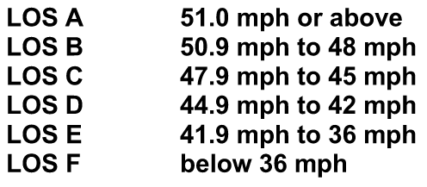
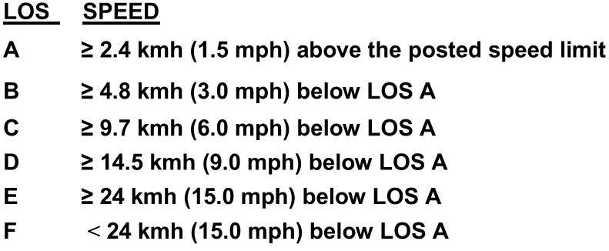
Countywide Traffic Study
Key Question: How do we evaluate our traffic levels?
Traffic/Roads
2021 US 1 Arterial Travel Time and Delay Study
Overall US-1….LOS C
Plantation Key…………LOS C
Windley Key……………LOS D
Upper Matecumbe….LOS E
Tea Table.………………LOS A
Lower Matecumbe….LOS C
Level of Service Rankings - Overall US-1
Individual Segments
2021 to 2023 Draft Changes*
Level of Service Rankings - Roadway Segments
Overall US-1….C D
Plantation Key…….…..C D
Windley Key..………….D E
Upper Matecumbe.….E E
Tea Table.………….….. A B
Lower Matecumbe…..C B
Individual Segments
* BOCC considered the Draft 2023 Arterial Travel Time & Delay Study and approved recollection of data for some segments in 2024 due to excessive traffic signal and construction delays. In March 2024 BOCC moved to delay the new data collection based on an incomplete signal re-timing project.
Notes:
Now that we have an understanding of the local traffic conditions, let’s “drive-home” how our traffic levels are evaluated. Monroe County has a consultant that conducts the US-1 Arterial Travel Time and Delay Study on a biennial basis to monitor the level of service on US-1. The study is typically conducted in peak season by completing 14 round trips in March from Key West to Dade and vice versa, and measuring the time and delays for each of the trip segments.
The result of the study is a summary of the level of service for US-1 and is further broken down by each of its segments. For overall US-1, the roadway is scored by comparing the average travel speed of the runs to 45 mph. The road segments are individually scored by comparing the average travel speed in relation to the posted speed limit for each segment. You can see the level of service ranking systems for each here. For example, if average traffic flow is 1.5 mph above the speed limit, we know that road segment is operating at a LOS A.
In the 2021 study, US-1 ranked at LOS C, Plantation Key – C, Windley Key – D, Upper Matecumbe – E, Tea Table – A, and Lower Mat – C.
In 2023, a draft study was conducted but the results were not approved by the county, who chose to gather additional data due to excessive traffic signal and construction delays, and the potential for improved traffic flow conditions following FDOT signal improvements. In March 2024, BOCC motioned to delay the collection of new data as the signal re-timing project had not been completed. The new data will be collected in 2025.
In the 2023 draft study, US-1 dropped from C to D, Plantation Key dropped C to D, Windley Key dropped D to E, Upper Mat remained an E, Tea Table dropped from A to B, and Lower Mat increased from C to B.

Slide 4
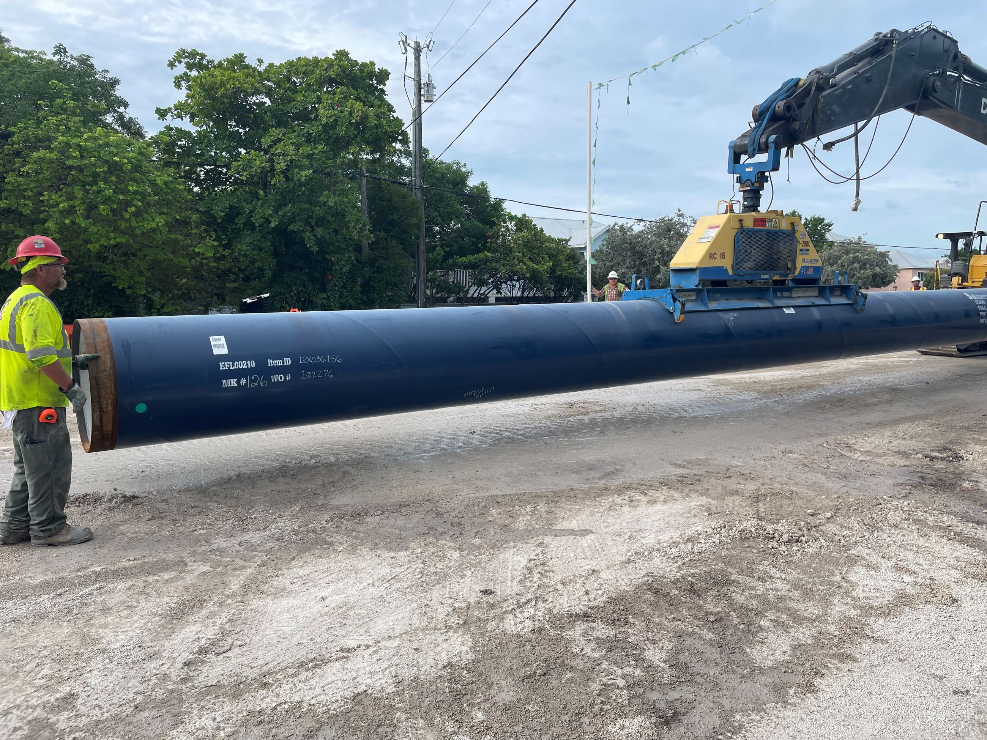
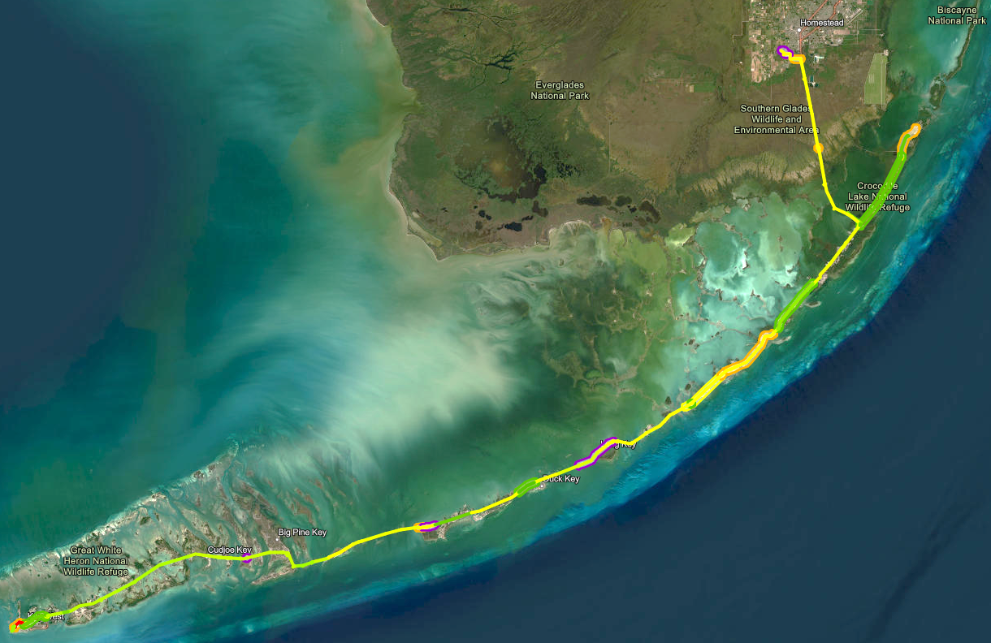
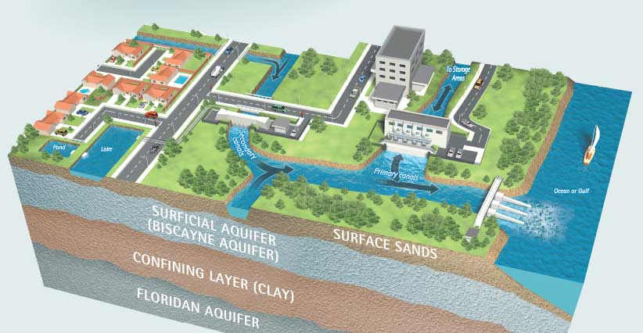

FKAA - Potable Water Supply
Potable Water
Existing Capacity
Florida City Water Treatment Plant - Permitted Max Day - 29.8 MGD
Biscayne Aquifer - Lime Treatment - 23.8 MGD (Firm capacity-18 MGD (Drought-17 MGD))
Floridan Aquifer - Reverse Osmosis - 6 MGD (Firm capacity-4.5 MGD)
Marathon Reverse Osmosis Plant - 1 MGD
Stock Island Reverse Osmosis Plant - 2 MGD
26 Pumping Stations
15 Aquifer Wells
48 Million Gallons of Storage
Emergency Backup - Two 1,000 Horsepower Diesel Pumps and Forty-Five Thousand Gallons of Fuel in Storage.
Proposed Capacity
Stock Island Reverse Osmosis Plant - 4 MGD
Crawl Key Reverse Osmosis Plant - 4 MGD
Islamorada Projects
Islamorada Transmission Main MM 79 to MM 84 – Completed July 29, 2024
Windley Key Transmission Main – Expected Completion Jan 2025
Snake Creek Crossing
Plantation Key Transmission Main Replacement – Estimated Construction 2026
Source: SFWMD
Notes:
Let's transition, or should I say “transmission” to potable water. Our water supply is serviced and maintained by the Florida Keys Aqueduct Authority (FKAA). Water is treated at the Florida City Water Treatment Plant and pumped through a 130-mile-long transmission main at a max pressure of 250 psi. The primary water source is the Biscayne Aquifer, just west of Florida City. There is a secondary aquifer, the FloriDAN aquifer, which is treated by reverse osmosis to supplement the Biscayne Aquifer.
Water use from the Biscayne Aquifer is regulated by SFWMD at 17.79 MGD during regular conditions and at 17 MGD in drought conditions. In conditions that require excess demand, water is pulled from the Floridan Aquifer system which has a capacity of 6 MGD. FKAA also has two RO plants in the keys, one in Marathon which can currently supply 1 MGD and one in Stock Island with 2 MGD. FKAA is working to increase the capacity of the keys RO plants to 4 MGD.
As you may have seen in Islamorada, FKAA is replacing the 1980’s water main pipes with larger and more resilient pipes. New pipes are cathodically protected from saltwater degradation and are being routed deep underground at bridge crossings, further protecting the infrastructure from wind and surge damage. FKAA also maintains storage tank facilities and pump stations throughout the keys to ensure continual service. Additionally, there are emergency backup pumps and 45,000 gallons of fuel in storage. As an example of emergency capacity, the diesel pumps were run for 28 days continuously after Hurricane Andrew.

Slide 5
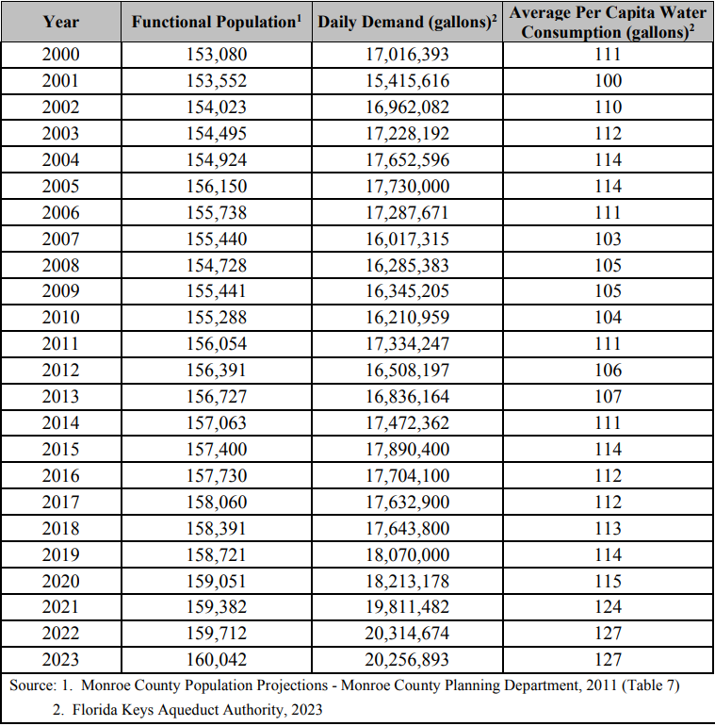
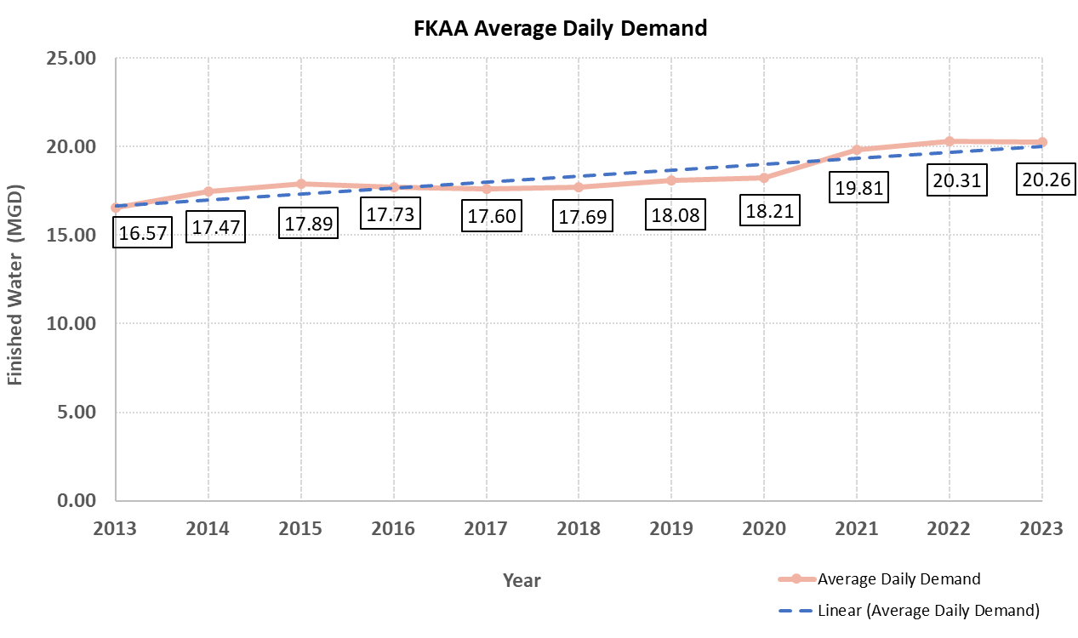
FKAA - Potable Water Demand
Potable Water
*Data provided to Islamorada by FKAA on 8/13/2024
Per 2023-2025 Monroe County Biennial Public Facilities Capacity Assessment Report
Notes:
Now that we have a “taste” for the source and the system for our fresh water, let’s review the average daily demand on the system. The first table provides a listing of functional population projections, average daily demand in gallons, and average per capita water consumption in gallons from the years 2000 to 2023. As shown by the table, there have been periods of fluctuation where the water demand varied but generally remained under 18 MGD until 2019. In turn, 2019 was the first year where the demand was greater than 18 MGD and has remained above 18 MGD ever since. The chart on the right shows a more recent timeframe from 2013 to 2023. There have been some incremental increases in the average water demand over the last 5 years, and the demand for 2023 is at 20.26 MGD.
FKAA continually monitors and tracks system conditions and plans for future changes that are necessary to continue supplying the keys with an adequate water supply. Between the aquifers and the RO plants, there is capacity to satisfy our potable water demands.

Slide 6
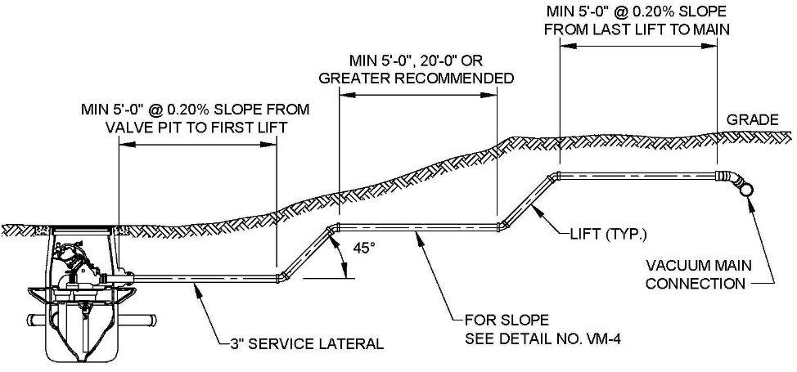
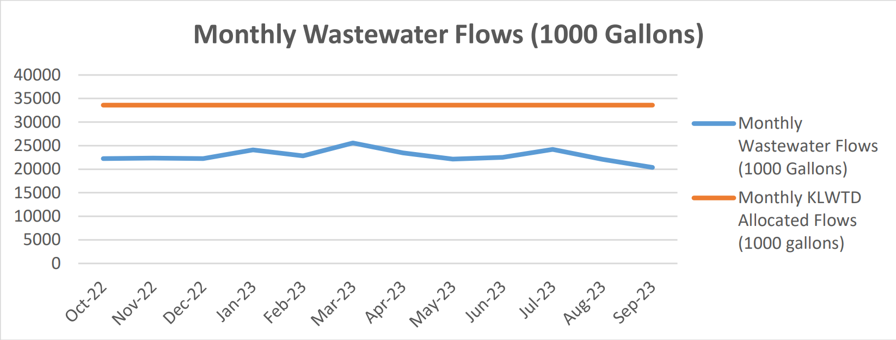
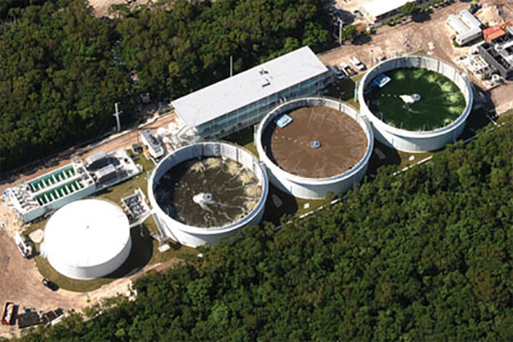
Wastewater
Village maintains vacuum & low-pressure systems after a ~ $130M septic to sewer conversion between 2012 and 2016.
Wastewater is piped to Key Largo Wastewater Treatment District (KLWTD) for treatment.
Working on agreement with KLWTD on a booster project that should reduce wear and tear on system.
Village consultant Wade Trim will be conducting a capacity study to evaluate our system and plan for future needs.
Wastewater
Per Sept 2023 Wastewater Utility Report
https://www.islamorada.fl.us/DocumentCenter/View/2885/WASTEWATER-UTILITY-REPORT--092023pdf
Notes:
We will now discuss the water that does not taste good, wastewater. In the past, many homes utilized septic tanks with drain fields and businesses used outdated package treatment plants. These sanitary systems were prone to neglect and leaks and contributed to water quality issues. The State of Florida issued a legislative mandate for improved wastewater treatment and disposal standards in 2010. This led to Islamorada tackling a $130 million dollar septic-to-sewer conversion program between 2012 and 2016. Upon completion, the Village of Islamorada now maintains a centralized vacuum & low-pressure wastewater system to collect our wastewater. What gets collected in our pipes is subsequently sent up to Key Largo through a low pressure force main. We have an interlocal agreement with Key Largo Wastewater Treatment District, who provides treatment for the wastewater. As you can see in the graph below, our monthly wastewater flows remain well under the allocated flows from KLWTD.
One of the challenges faced by the system is continual maintenance. Like any system, parts are prone to breaking and leaking. However, we have a hard-working team who anticipates problems and are always ready to respond to issues. One of the projects being planned is a booster pump station in north plantation key. Once installed, this booster is anticipated to reduce wear and tear on our system by providing a means to send a more uniform flow, eliminating some hammering and air issues encountered with the pipe and pump systems.
I’ve spoken with AJ Englemeyer, our public works director regarding his take on the future capacity of our system. Our system is currently operating well within our design capacity. The original design was created with a factor of safety built in for future developments. Our wastewater consultant, engineering firm Wade Trim, is going to be conducting a capacity study to evaluate future needs and anticipate improvements before they become an issue. This will be conducted over the next budget year.

Slide 7
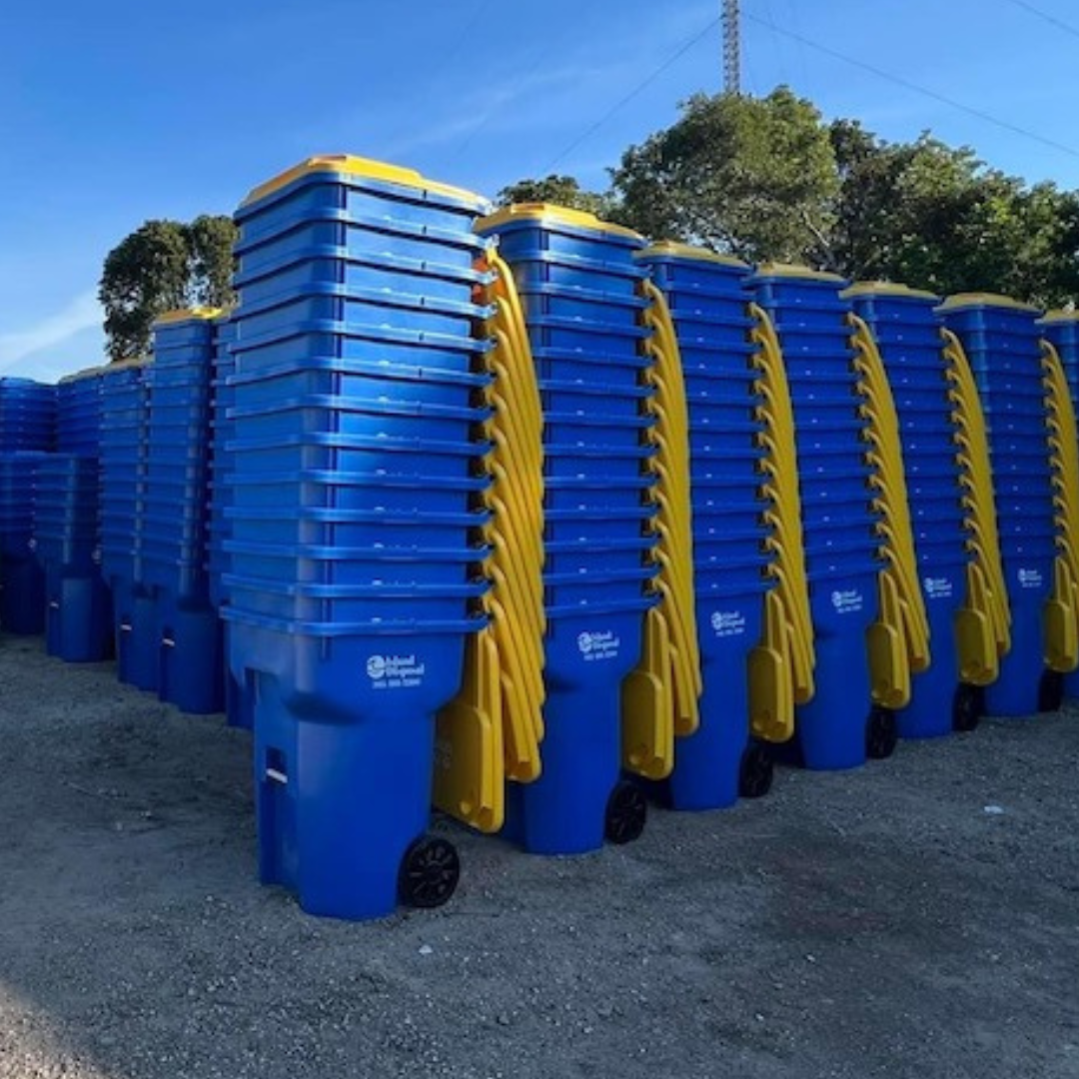
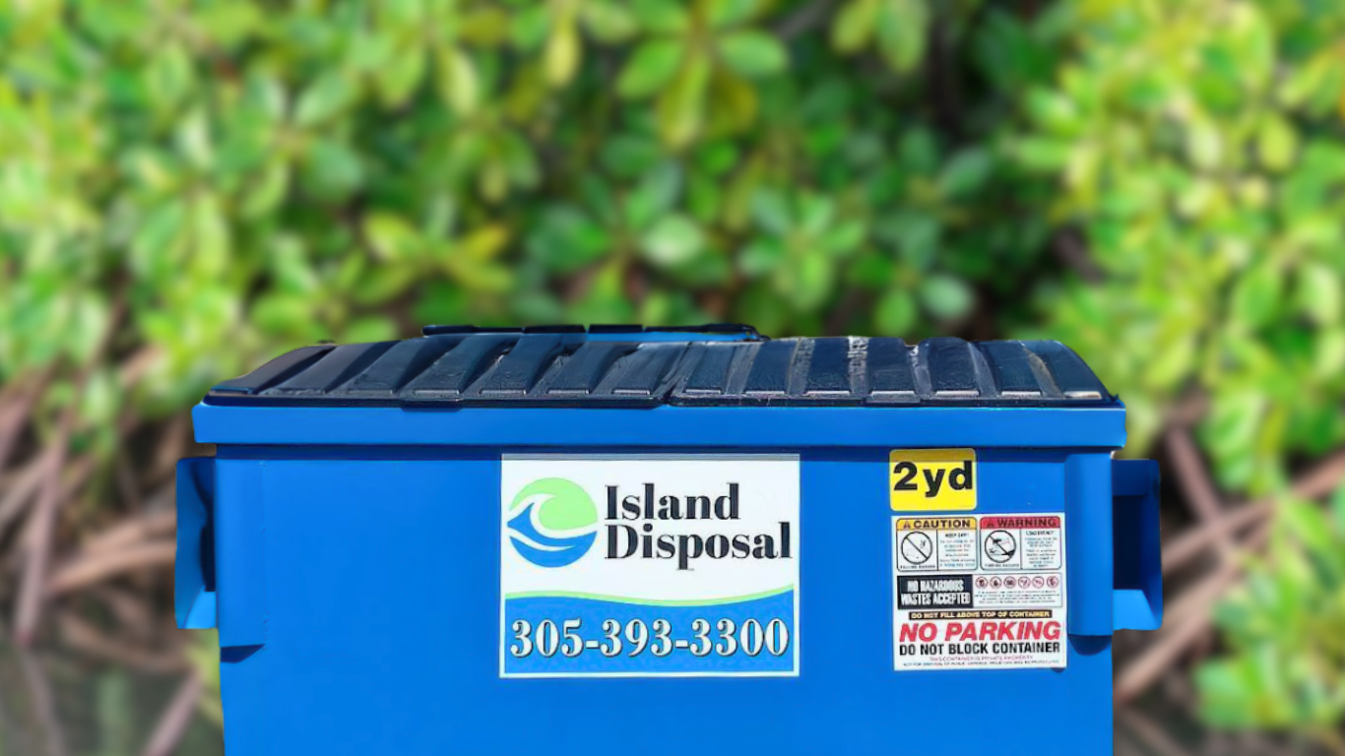

Solid Waste
Solid Waste
Island Disposal became the waste hauler for Islamorada on Jan 1, 2024.
Retained staff from previous hauler that knew routes for seamless transition.
Increased system efficiency by using trucks with automated arms.
Waste is hauled to either Layton or Card Sound Transfer Stations, then out of the Keys.
The biggest challenges faced by Island Disposal are not related to our volume of trash.
Island Disposal is confident in their ability to provide hauling service regardless of future development.
Trash gets transferred to the Solid Waste Authority of West Palm Beach Renewable Energy Facility.
Notes:
Let’s not “waste” any time transitioning this discussion to Islamorada’s solid waste infrastructure. Island Disposal is our solid waste hauler since Jan 1, 2024.
I spoke with their operations manager, Jonathon Lindback, about the current and future capacity of our solid waste and any issues they may anticipate in consideration to future building permit allocations. Island Disposal had a relatively seamless transition from the previous hauler. They were able to retain most staff that knew local routes and were able to increase pickup efficiency with the use of automated arms.
Solid waste from Islamorada is hauled to either the Layton landfill or the Card Sound Transfer Station, then hauled out of the keys. Garbage is transported to the Solid Waste Authority of West Palm Beach Renewable Energy Facility.
As far as the future capacity of Island Disposal, they are confident in their ability to service Islamorada continually regardless of the amount of development that takes place. Jonathon felt that they could easily accommodate extra routes with minimal changes to staffing or equipment.

Slide 8
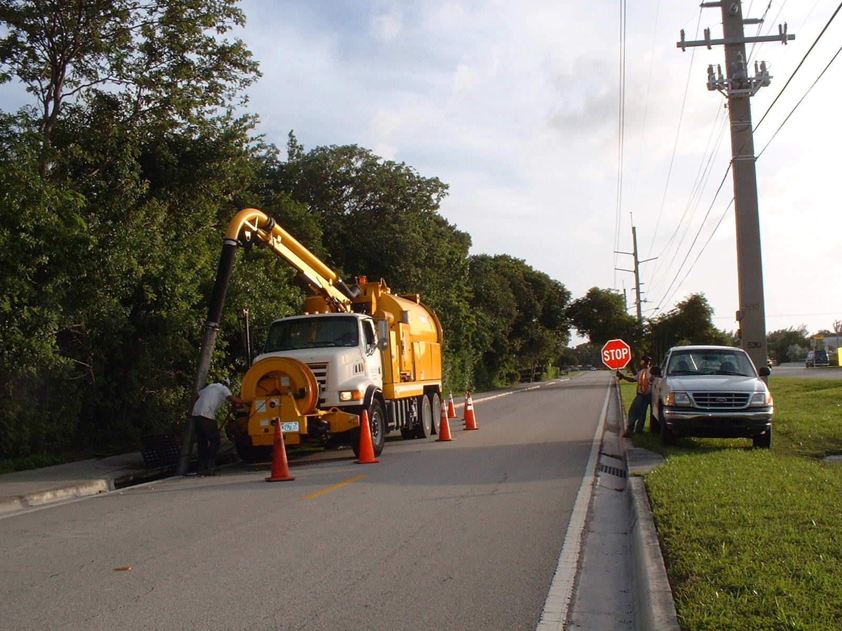
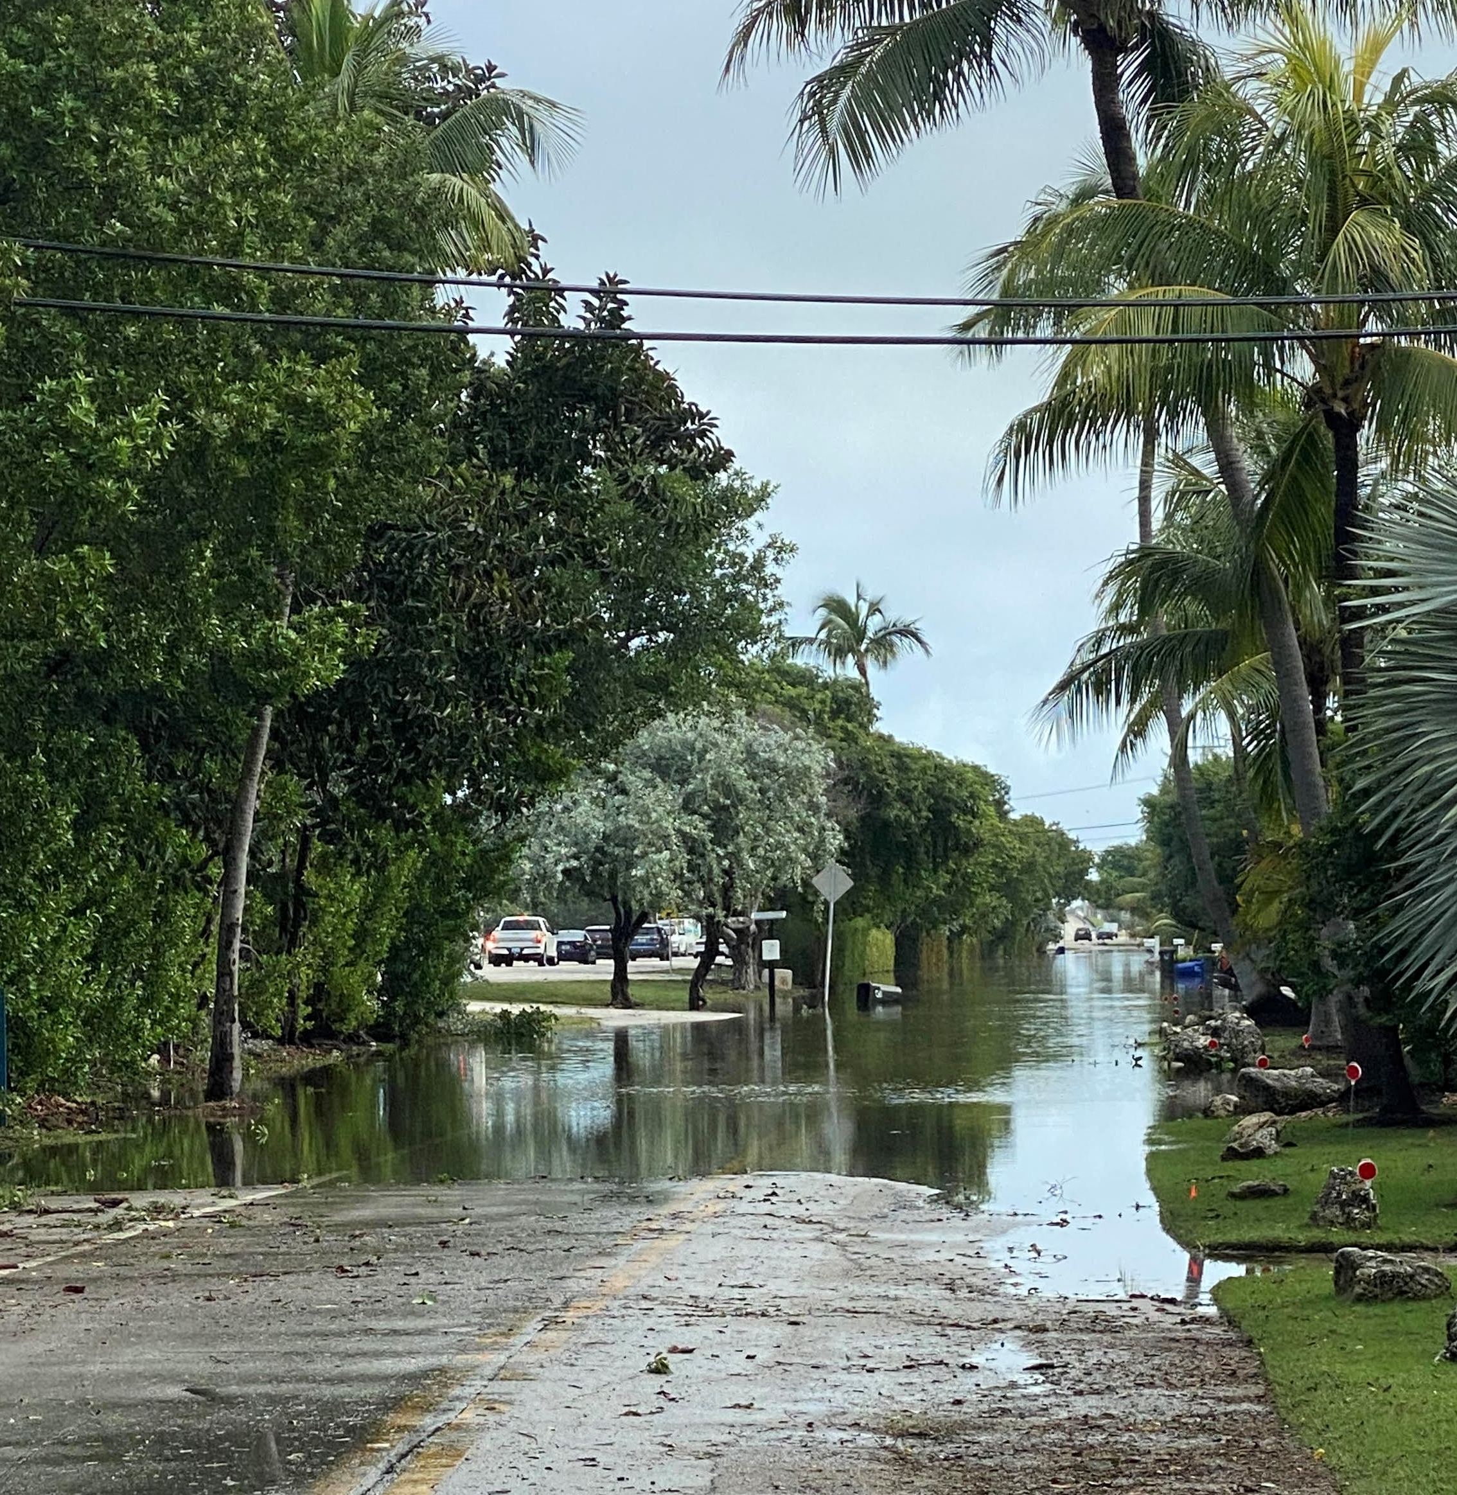
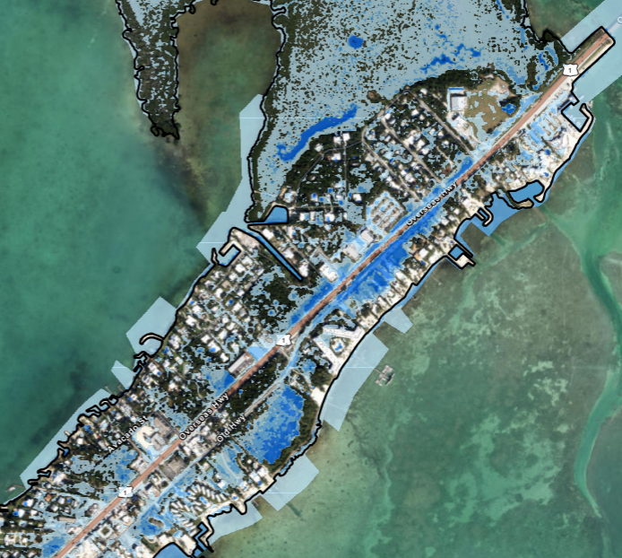
Stormwater
Stormwater management is regulated and inspected for the creation of all new impervious areas.
Goals: Safe management, prevent adverse water quality impacts, protect natural areas.
Future Planning: RFP 23-19, WSP selected as our stormwater master plan consultant. In negotiation now to finalize contract.
Stormwater master plan will address water quality, current and future flood risks, re-development & growth.
Serve as a guide for policy, improvements, projects, and funding for at least 10 years following plan completion.
Stormwater
Notes:
I hope this presentation has not been too “draining” but we are almost finished. The last topic focuses on stormwater around the Village. The Village does not maintain a centralized stormwater system, due to our unique geography and topography. We do, however, regulate and inspect stormwater management for all new development, for the purpose of providing safe management and disposal of runoff from developed areas, and to protect natural resources to minimize or eliminate potential adverse impacts to surface waters, shallow groundwater, and natural resources areas within the Village.
One of the stormwater developments in the Village is the upcoming stormwater management plan. The Village is currently working with WSP to finalize the scope of work for our new stormwater master plan. This master plan will be created to analyze and address the following topics: water quality, current and future flood risks, re-development, and growth. The plan will be looking into areas of future tidal flooding as well. The new plan will guide our stormwater management program for the next 10 or more years, including analyzing and refining our stormwater related policies, and providing a capital improvements plan for stormwater projects on a 10-year time frame with projects recommended by priority and cost to benefit ratio. These projects will focus on reducing runoff rates, increasing storage volumes, and reducing pollutants.
Also, there will be financial and funding recommendations to assist with these projects. Based on the final project and cost considerations, recommendations for funding sources will be made including grants, public-private partnerships, bonding, and loan funds.

Slide 9
Thank You for Attending!
Contact Information:
Rob Mather, Planning Review Engineer
Email: Robert.Mather@islamorada.fl.us
Phone: (305) 664-6416

